Slide 1
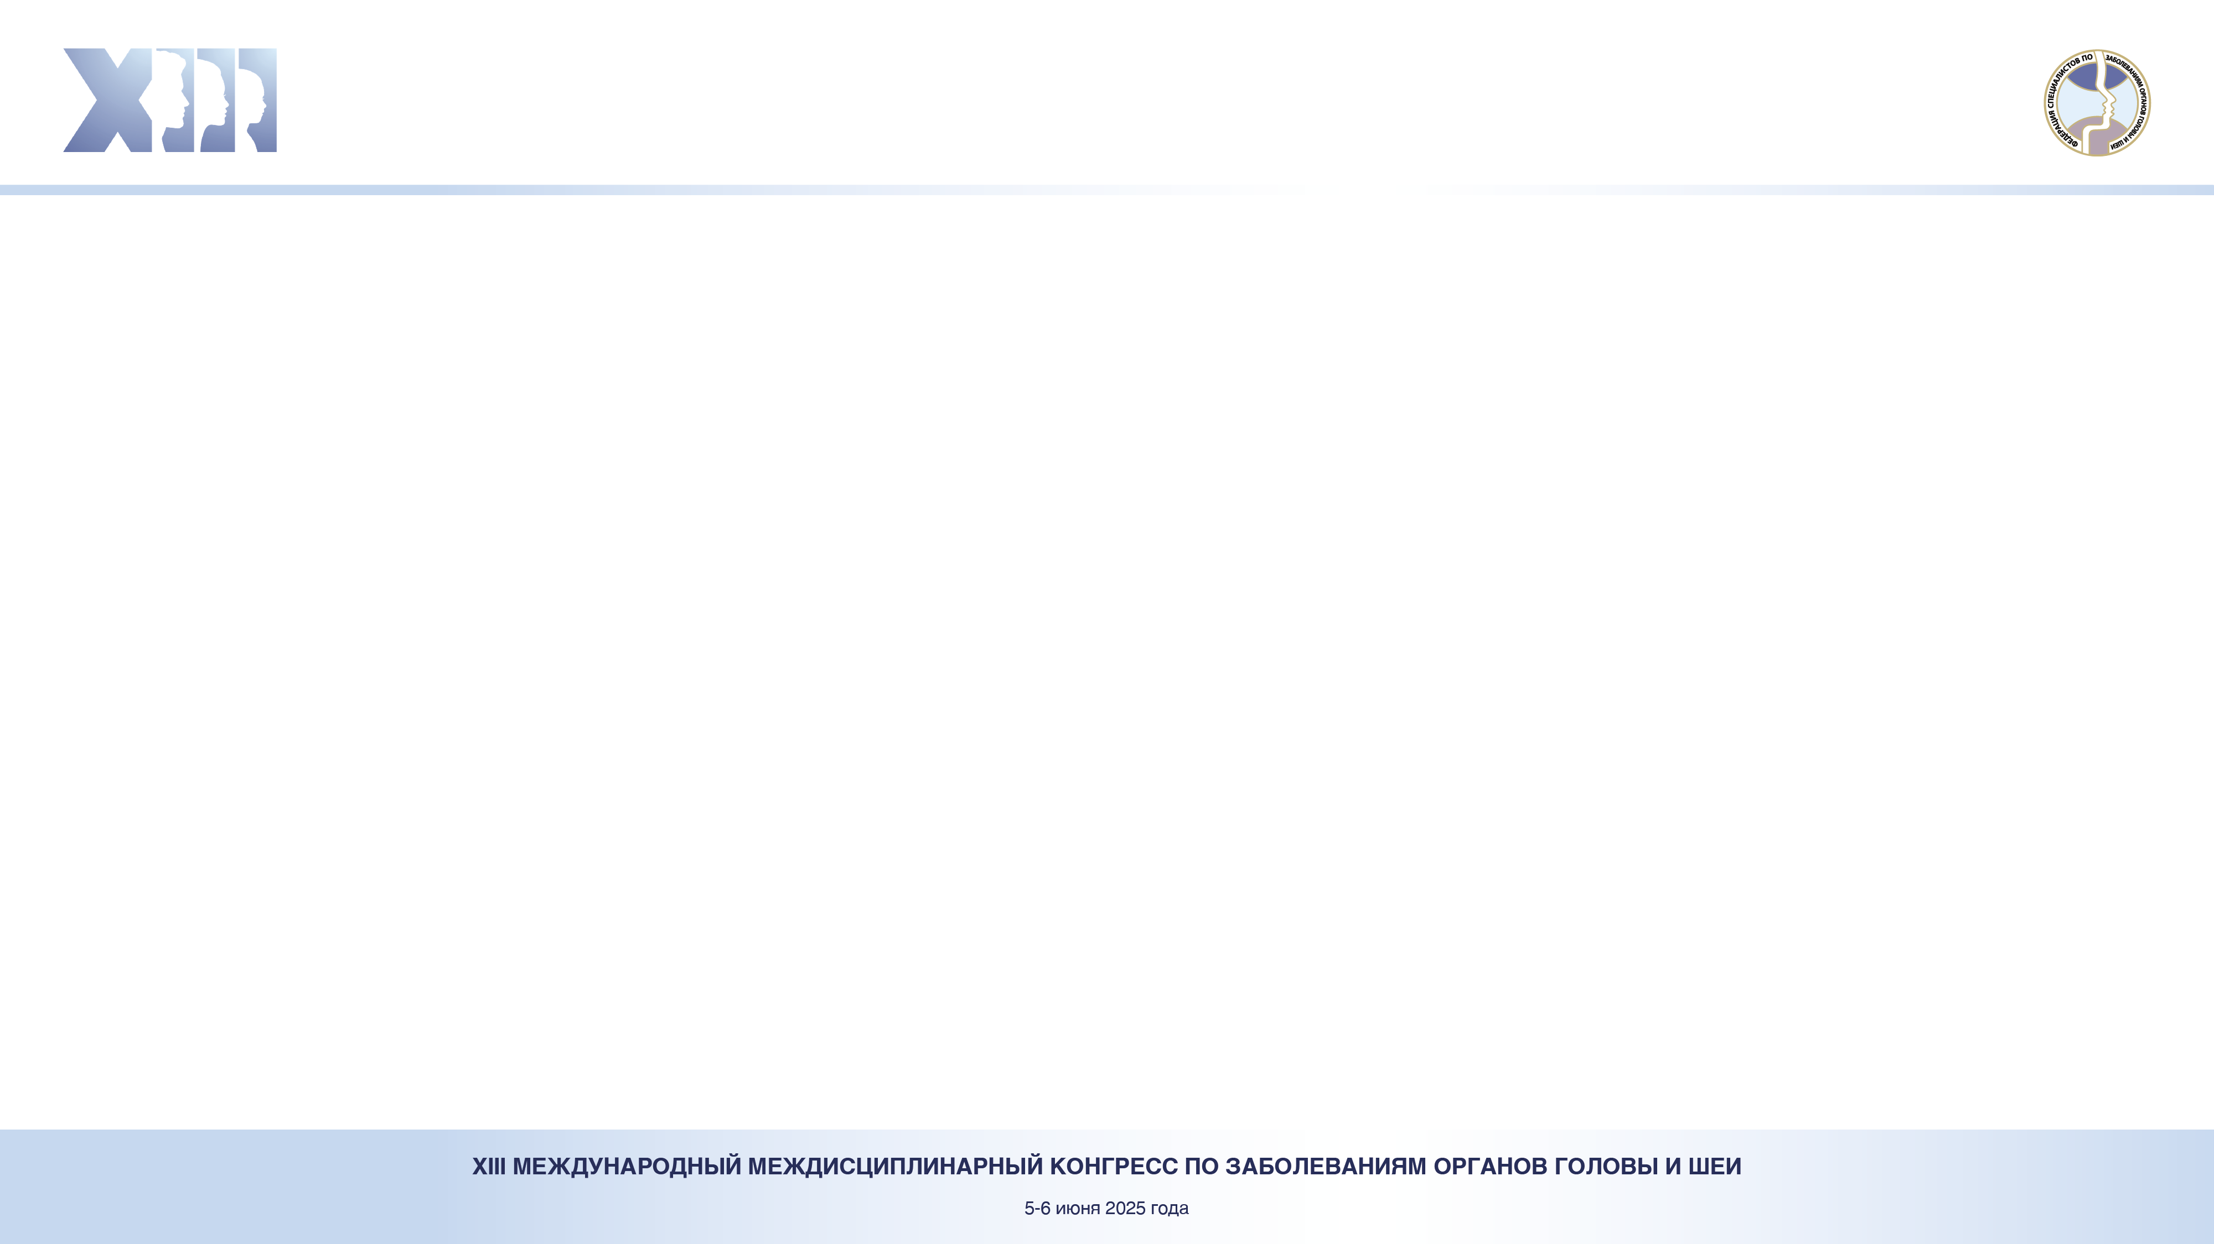
Название
Имя Фамилия, Имя Фамилия,
Название университета
Background. Simulation of rat septoplasty by scarification of the mucous membrane of the nasal septum leads to changes in animal behavior, an imbalance in the autonomic nervous system, and the appearance of dark neurons in the hippocampus.
Objective. to study the local effect of modeling septoplasty in rats during scarification of the nasal septum.
Methods. In 10 male rats of the Wistar strain of the experimental group (ExpG), the mucous-perichondrium layer of the nasal septum was scarified. The control group (CG) consisted of 5 male rats of the same line. Animals were slaughtered 3 days after surgery. After decalcification of the facial skeleton of rats, histological sections were stained with H&E. For statistical analysis of the results, the Mann-Whitney test was used.
Results. In ExpG, at the sites of nasal septum scarification, the leukocyte shaft was 45.43 ± 1.07 μm. The average values of this indicator for each rat in ExpG did not differ (p <0.001).
There was edema, hyperemia and diapedetic hemorrhage in the submucosa. Focal periductal mononuclear infiltrates in the gland. A narrowing of the common nasal passages was noted due to edema, which covered the nasal septum adjacent to the damage zone.
Conclusion. Scarification of the nasal septum in rats is accompanied by characteristic inflammatory phenomena, both in areas of direct damage and in areas close to them. Thus, this method of damage to the mucous membrane of the nose simulates inflammation after septoplasty in humans
Пример оформления текстовой части
Рис. 1 Название
Рис. 2 Название

